Slide 1
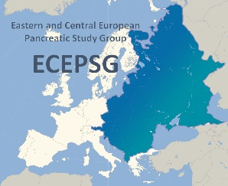
4th Conference of the Hungarian & 2nd Conference of the Eastern and Central European
Pancreatic Study Groups
PROSPECTIVE CLINICAL TRIALS
PROSPECTIVE CLINICAL TRIALS
Péter Hegyi
SZEGED, HUNGARY
Chair of HPSG
on behalf of
the Hungarian Pancreatic Study Group
Hungarian Pancreatic Study Group – Magyar Hasnyálmirigy Munkacsoport

Slide 2
4th Conference of the Hungarian & 2nd Conference of the Eastern and Central European
Pancreatic Study Groups
PROSPECTIVE CLINICAL TRIALS
HORIZONTAL STUDIES
GENERAL REGISTRY
ACUTE PANCREATITIS
PREPAST
CHRONIC PANCREATITIS
AUTOIMMUNE PANCRETITIS
EASY
APPLE
PANCREATIC CANCER
PNEAPPLE
Hungarian Pancreatic Study Group – Magyar Hasnyálmirigy Munkacsoport

Slide 3
4th Conference of the Hungarian & 2nd Conference of the Eastern and Central European
Pancreatic Study Groups
PROSPECTIVE CLINICAL TRIALS
IMPORTANT!
The protocols have to be discussed in one of the international meetings
The studies have to receive the relevant ethical approvals issued by the National Hungarian Ethical Authority (In Hungary: ETT TUKEB).
The trials have to be registered at the ISRCTN registry is a primary clinical trial registry recognized by WHO and ICMJE.
Authorhip policy should be provided in advance
The studies have to be open for all centers throughout the world.
5. Electronic CRF has to be developed.
The study should be sent to the IAP Scientific Committee
The TRIAL article (prestudy protocol) has to be published
WE CAN DO THAT FOR ALL STUDIES
Hungarian Pancreatic Study Group – Magyar Hasnyálmirigy Munkacsoport

Slide 4
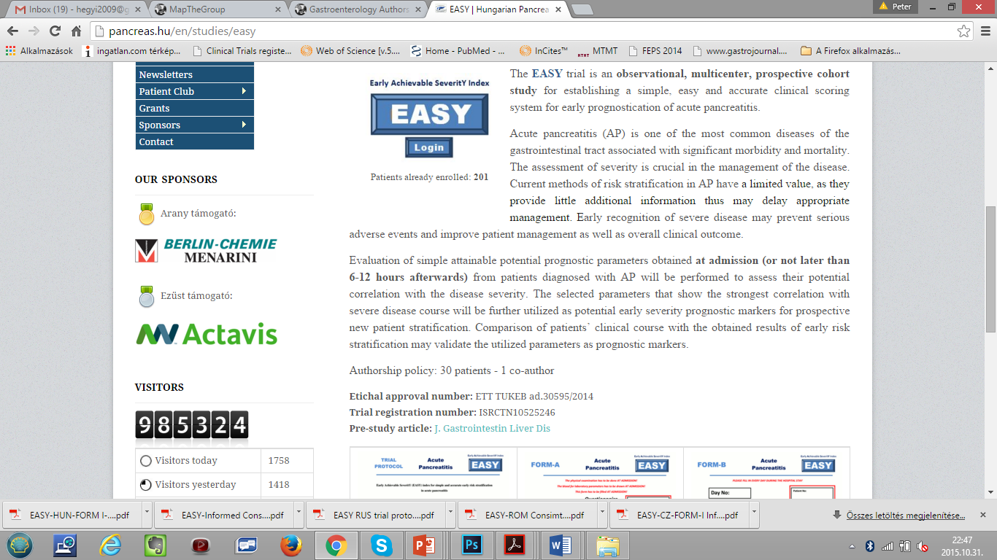
4th Conference of the Hungarian & 2nd Conference of the Eastern and Central European
Pancreatic Study Groups
PROSPECTIVE CLINICAL TRIALS
Hungarian Pancreatic Study Group – Magyar Hasnyálmirigy Munkacsoport

Slide 5
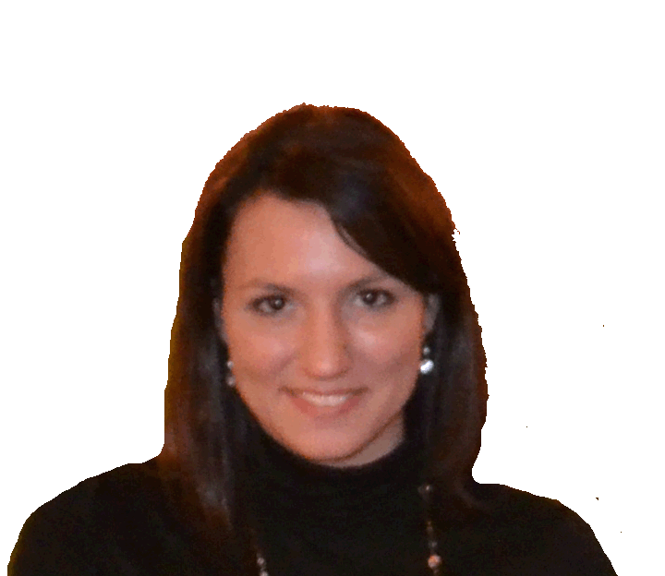
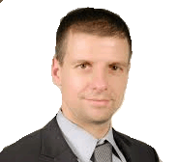

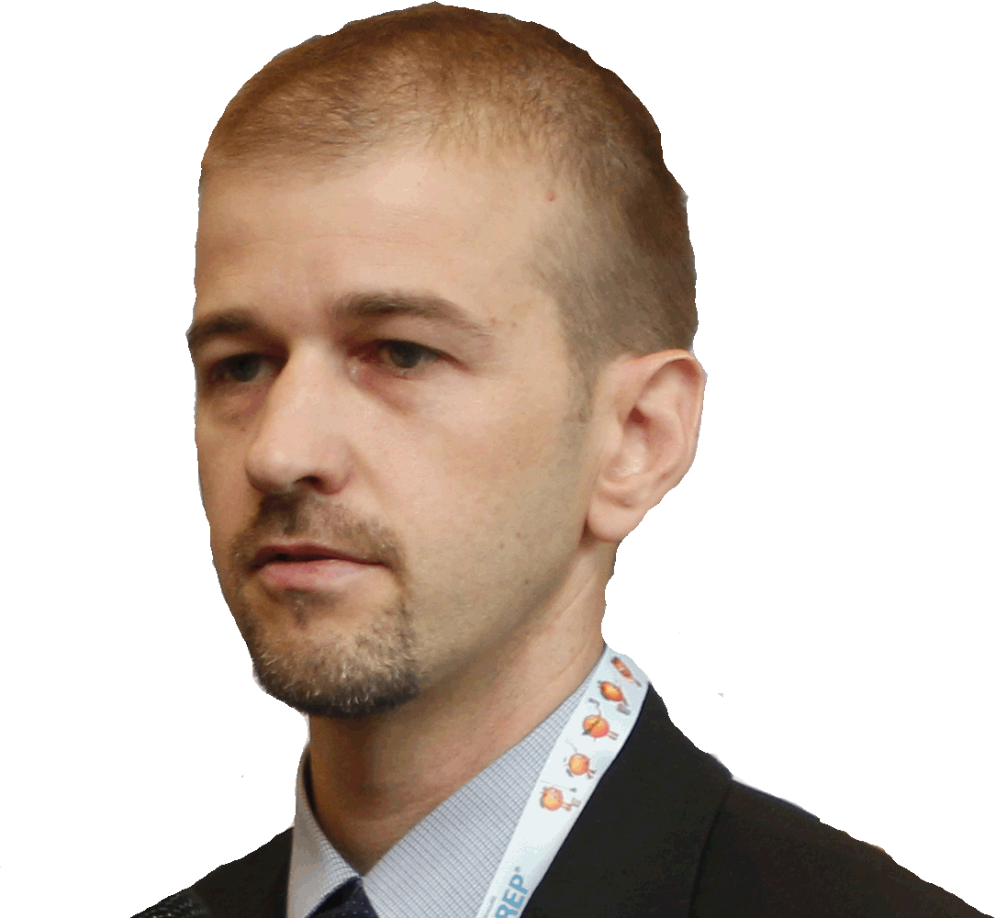
4th Conference of the Hungarian & 2nd Conference of the Eastern and Central European
Pancreatic Study Groups
PROSPECTIVE CLINICAL TRIALS
ISTVÁN HRITZ
ANDREA PÁRNICZKY
EASY
APPLE
ZSOLT DUBRAVCSIK
DÓRA MOSZTBACHER
PREPAST
PINEAPPLE
Hungarian Pancreatic Study Group – Magyar Hasnyálmirigy Munkacsoport

Slide 6
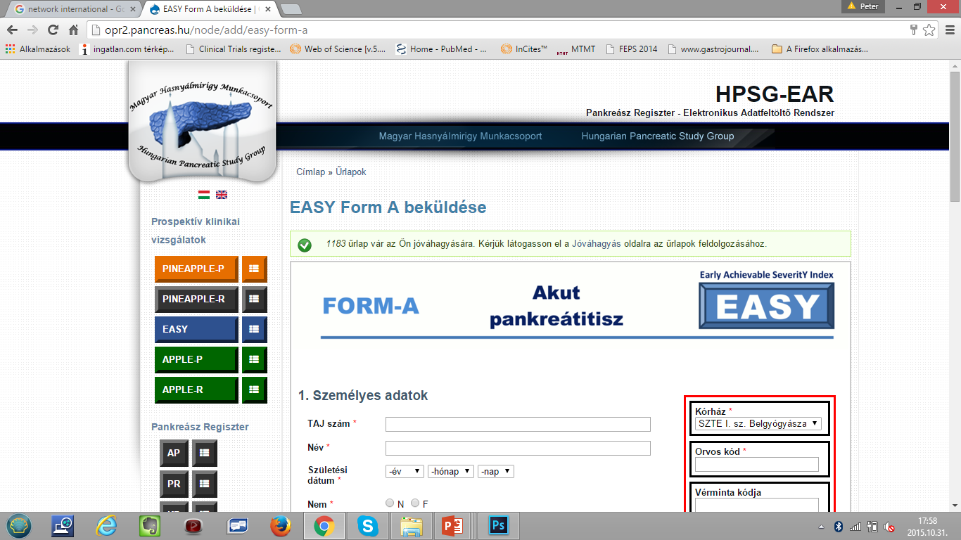
4th Conference of the Hungarian & 2nd Conference of the Eastern and Central European
Pancreatic Study Groups
PROSPECTIVE CLINICAL TRIALS
Prospective
trials
Hungarian Pancreatic Study Group – Magyar Hasnyálmirigy Munkacsoport

Slide 7
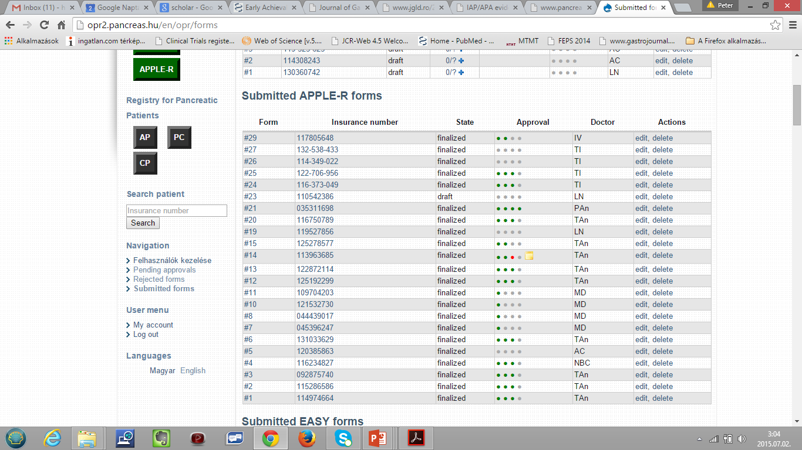
4th Conference of the Hungarian & 2nd Conference of the Eastern and Central European
Pancreatic Study Groups
PROSPECTIVE CLINICAL TRIALS
QUALITY CONTROL
LOCAL ADMINISTRATOR (CLINICAL RESEARCH OFFICER)
LOCAL SUPERVISOR
REGISTRY ADMINISTRATOR
REGISTRY PI
Hungarian Pancreatic Study Group – Magyar Hasnyálmirigy Munkacsoport

Slide 8



4th Conference of the Hungarian & 2nd Conference of the Eastern and Central European
Pancreatic Study Groups
PROSPECTIVE CLINICAL TRIALS
PLEASE COME UP WITH TRIALS!
PI
CENTRAL OFFICE
FOR CLINICAL TRIALS
Leader:
ANDREA SZERNTESI
ethical approval
registation at ISRCTN
electronic CRF
IAP Scientific Committee
PA
Hungarian Pancreatic Study Group – Magyar Hasnyálmirigy Munkacsoport

Slide 9


4th Conference of the Hungarian & 2nd Conference of the Eastern and Central European
Pancreatic Study Groups
HUNGARIAN COHORT - PANCREATIC CANCER (PC)
Thank you for
your attention!
THE HUNGARIAN PANCREATIC STUDY GROUP
IS COMMITTED TO IMPROVING
THE LIFES OF PATIENTS SUFFERING FROM
PANCREATIC DISEASES!
www.pancreas.hu
Hungarian Pancreatic Study Group – Magyar Hasnyálmirigy Munkacsoport

